Slide 1
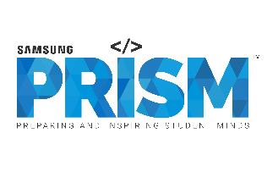
[Samsung PRISM] Mid Review Report
Malayalam and ASR Model for Rasa Using Spacy
Team
College Professor(s): Prof Geetha and Prof Jayanthi M.G
Students:
A Devipriya (ECE)
Ashwin Suresh (CSE)
Abhijith (CSE)
Alfred M Abraham (CSE)
Department: CSE
Date: 2 Nov. 2021

Slide 2
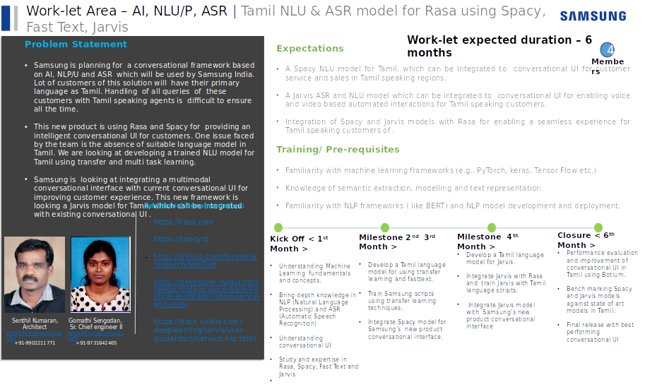

Slide 3
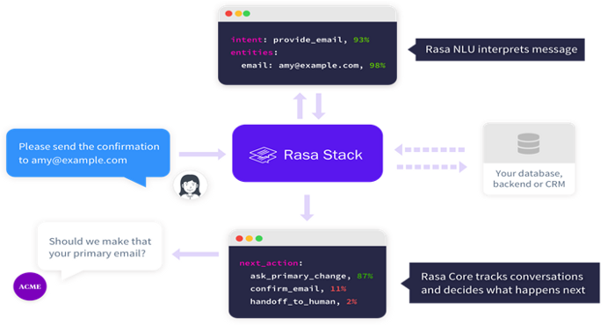
Proposed Approach / Solution
Concept Diagram :
Source : https://chatbotslife.com/making-of-chatbot-using-rasa-nlu-rasa-core-part-1-7138c438581f

Slide 4
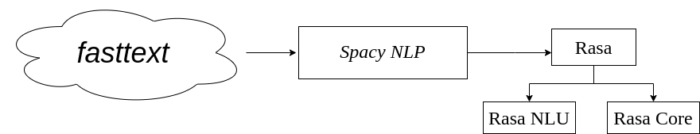
Proposed Approach / Solution
Concept Diagram :

Slide 5
Dataset(s) Analysis / Description
Dataset Capture / Preparation / Generation :
(Discuss the dataset generation process or if downloaded data provide details of what data & from where it was obtained etc… - 2 to 3 bullets only)
We are still waiting for SRIB to provide the actual dataset.
We have used a random dataset to test the working of RASA.
Dataset Understanding / Analysis :
(Provide 2 to 3 bullets about what is your understanding of the data / opinion about the data)
Understanding of rasa framework.
Understanding of transfer learning and fasttext library.
Implemention of the Malayalam model on rasa framework using random data.
Dataset Pre-Processing / Related Challenges (if any) :
(List out the challenges you fore see in data handling wrt problem definition – 2 to 3 bullets only)
To create the project using rasa framework.
Complications while installation of anaconda.

Slide 6
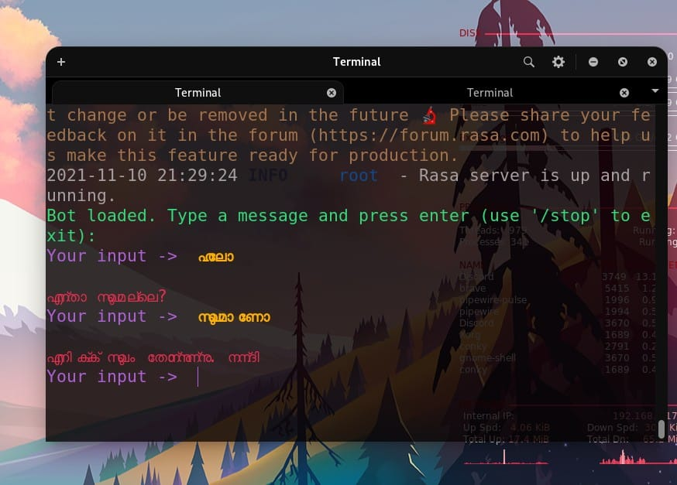
Experimental Results / Simulations / Observations
Results :
(provide numerical data / bar charts / plots / images / videos / tabulated results etc. Use full slide or multiple slides up to max 3 slides to demonstrate the results)

Slide 7
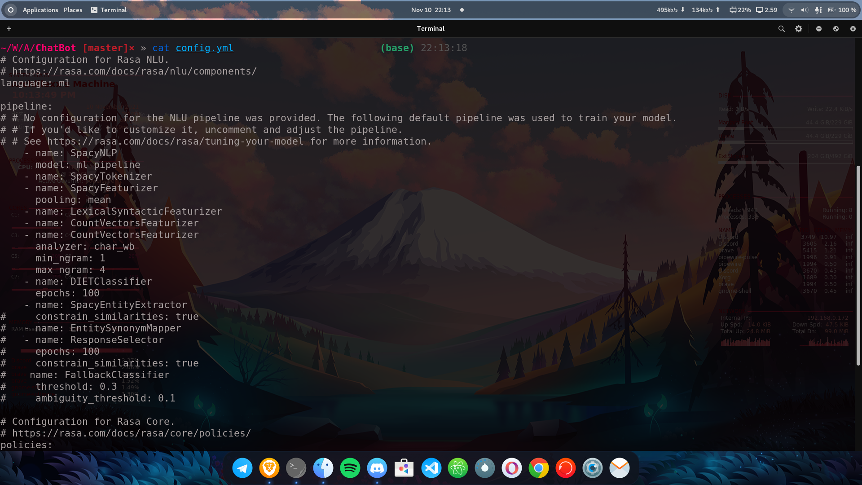
Experimental Results / Simulations / Observations

Slide 8
Further Plan to Complete Project
Final Probable Deliverables :
(Discuss in the form of bullets, what are the next steps to complete the solution, any roadblocks / bottlenecks, any support needed from SRIB)
Integrate Jarvis with Rasa and train Jarvis with Malayalam language scripts.
Final release with best performing conversational UI.
Needed Support
We need some support from SRIB to check if the Malayalam word vector model is properly loaded into the bot.
IP Target / Plan :
(Any possibility of papers / patentable ideas / innovative aspects that can lead to patentable ideas)
No

Slide 9
Further Plan to Complete Project
Completion Plan:
(High level plan to complete the project in next 8 weeks after review, in format below)
Week 1 to 2
Step 1 Train Samsung scripts using transfer learning techniques.
Step 2 Integrate Spacy model for Samsung’s new product conversational interface.
Week 2 to 4
Step 1 Develop a Malayalam language model for using transfer learning and fasttext.
Step 2 Integrate Jarvis with Rasa and train Jarvis with Malayalam language scripts.
Week 5 to 6
Step 1 Integrate Jarvis model with Samsung’s new product conversational interface
Step 2 Performance evaluation and improvement of conversational UI in Malayalam using Botium.
Week 7 to 8
Step 1 Benchmarking Spacy and Jarvis models against state of art models in Malayalam.
Step 2 Final release with best performing conversational UI.
Challenges Anticipated:
Commands mentioned to upload the word vector model team were outdated.
https://github.com/archillexx/ChatBot
Git Upload details:

Slide 10
Thank you

